Slide 1






PRESENTATION 2026
Student Name
Student Email
Mansi Pant
pantmansi388@gmail.com
Mentor Name
Sagar Mehta Sir

Slide 2

Outline
Abstract of the Project
Problem Statement
Proposed Solution
System Architecture
Live Demo of the Project
Embedded Video of Project
Conclusion
Future Scope

Slide 3

Abstract
This project uses power BI and Microsoft Copilot to anaylze banking data.
Convert complex data into simple visual dashboards.
Identifies customer patterns, risk levels, and finanical trend patterns.
Expected outcomes: Faster anaylsis, reduced manual effort, improved accuracy and better decision making.

Slide 4

Problem Statement
Difficulty in handling large banking data sets leading to error and slow analysis.
Traditional tools lack advanced analytics and efficiency making the problem significant .
Affects bank managers, employee, analyst and the customer .
Existing approaches power BI with Copilot have a limitation in scalability, accuracy and security .
Scope limited to banking dataset analysis using PowerBI and copilot that is no real time data .

Slide 5

Proposed Solution
Use Power BI and Microsoft Copilot to analyse and visualise banking data efficiently
Follow methodology:
Data cleaning ->Data analysis ->Dashboard creation
Solve issue of large data set handling. errors and slow manual processing
Provide interactive dashboard and AI generated insight for the better understanding
Key benefits:-Faster analysis, improved accuracy, reduce manual effort, better decision making
Innovation:- Combine data visualisation with Copilot for automated insights
Comparsion :-More efficient, scalable and user friendly than traditional Excel based analysis

Slide 6
System Architecture
Data Input / Source
Processing / Analysis
Kaggle banking dataset(CSV/Excel)
Contains 13 columns and 1500 rows
Fields like full name, country, age, gender,income level etc.
Data cleaning using Power BI remove duplicates and unwanted data columns
Data transformation and analysing using charts
AI / Tool Integration
Output / Dashboard
Power BI for visualization
Microsoft corporate for AI insight and summaries
Interactive dashboards[ Pie chart,Bar chat, scattered chart ]
Easy to understand reports for decision making

Slide 7
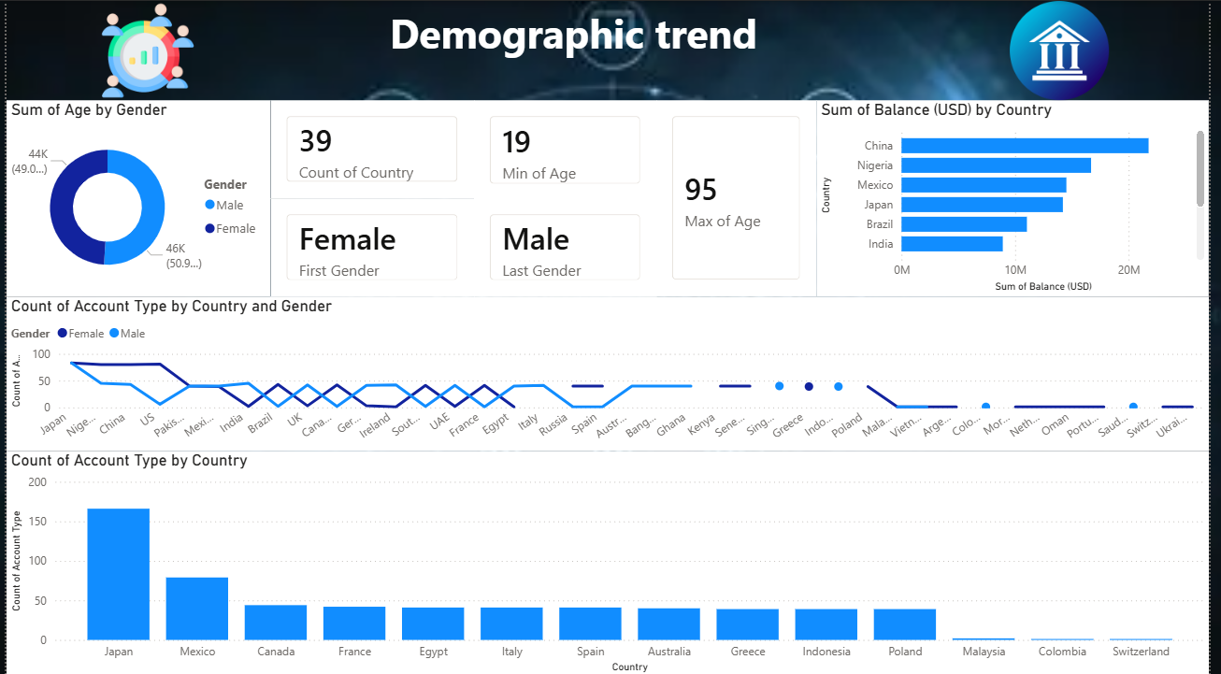

Slide 8
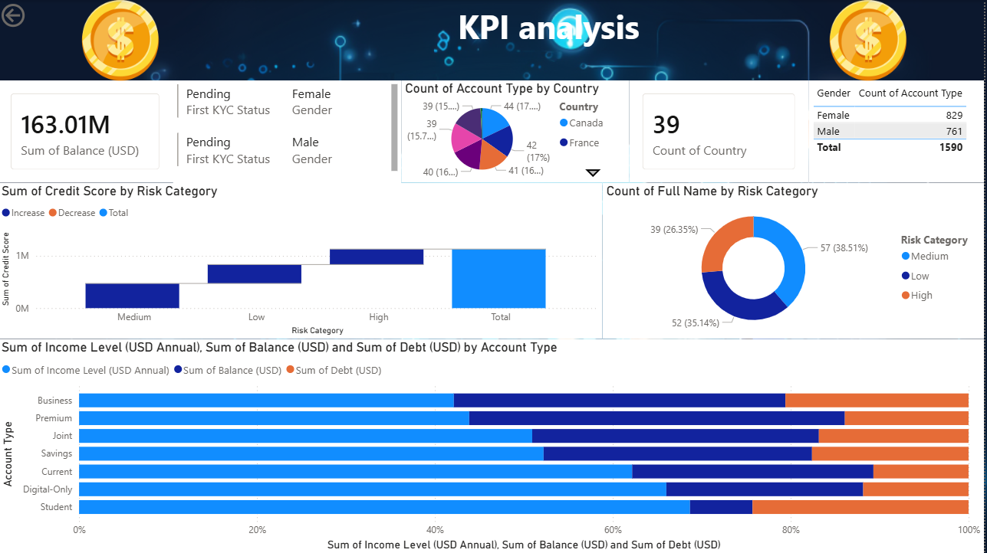

Slide 9
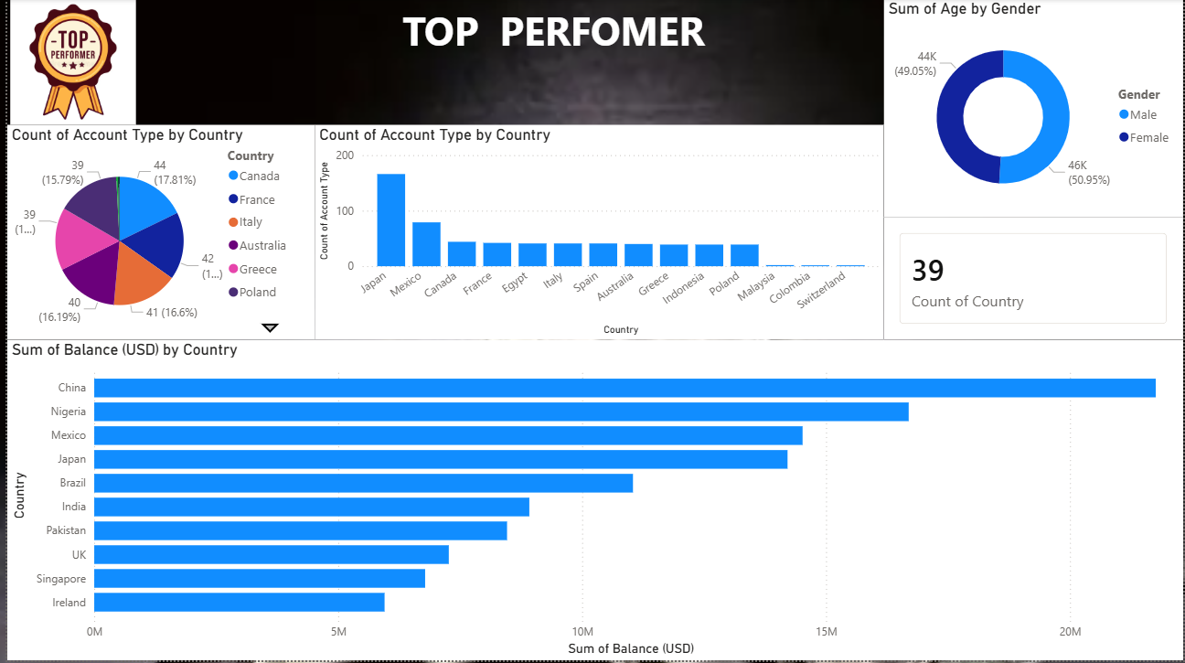

Slide 10
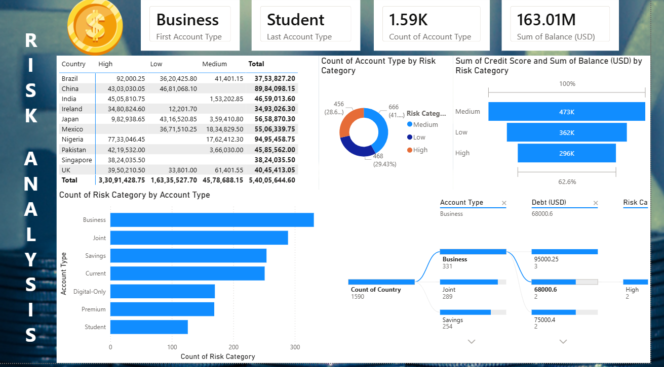

Slide 11
Live Demo of Project
Here's the list of some demo screenshots / features of the project:
Demo 1
Demo 2
Demo 3
[Add description of Demo 1 here — what this demo shows, key features, and results achieved.]
[Add description of Demo 2 here — what this demo shows, key features, and results achieved.]
[Add description of Demo 3 here — what this demo shows, key features, and results achieved.]

Slide 12
Video of Project Demo
[https://your-project-demo-link.com]
▶
[Insert your project demo video.
You can embed a video your live project.]

Slide 13

Conclusion
Used Power BI & Copilot for banking data analysis
Simplified complex data for better decisions
Created interactive dashboards (transactions, behavior, trends)
Copilot saved time with quick insights
Improved efficiency, accuracy, and productivity
Enhanced skills in data analysis and AI tools
CONCLUSION

Slide 14

Future Scope
Integrated real time data in power BI dashboard
Use advanced copilot feature for deeper AI insights.
Develop web/mobile dashboard using power BI services
Expand analysis using larger real world data set

Slide 15
Thank You
AICW Fellowship | Student Project Presentation 2026
LinkedIn | Edunet Foundation

